Slide 1
LLM Tokenomics
JULY 2026
Notes:
• Welcome — this is our point of view on LLM Tokenomics: the economics of tokens.
• Promise of the next 40 minutes: understand what a token costs to make, why bills explode anyway, and what to do about it.
• → Start with the one paradox that frames everything.

Slide 2
WHY TOKENOMICS
Cheaper tokens, bigger bills — the defining paradox
The price of a unit of intelligence is falling roughly 10× a year, yet enterprise LLM spend keeps doubling.
Agentic workloads burn 5–30× more tokens per task — consumption is outrunning deflation.
PRICE TREND
API SPEND 2025
−10×
$8.4B
▼ every year
▲ 2× in 2026
THE TAKEAWAY
AGENT MULTIPLIER
TOKEN WASTE
Treat tokens as a managed resource: meter, route, cache and batch — then reinvest the savings in scale.
5–30×
40–60%
▲ tokens/task
▼ removable
Notes:
• The core tension: unit prices fall ~10× a year, yet enterprise API spend passed $8.4B in 2025 and is doubling again in 2026.
• This is Jevons paradox, not a contradiction: cheaper tokens unlock agentic workloads that burn 5–30× more tokens per task.
• 40–60% of enterprise token spend is removable waste — that is the opportunity.
• Takeaway to land: treat tokens as a managed resource — meter, route, cache, batch — then reinvest savings in scale.
• → Here is the journey we'll take.

Slide 3
CONTENTS
What this point of view covers
01
LLM Primer: How LLMs produce tokens
02
The pricing landscape today
03
Supply-side cost drivers
04
Proprietary vs open-source tokenomics
05
Why enterprise bills become high
06
Levers for cost optimisation
07
A FinOps framework for AI
08
Forward trends & implications
Notes:
• Eight chapters: how tokens are made, how they're priced, what they cost to produce, open vs proprietary, why bills explode, the optimisation playbook, FinOps, and where this goes by 2030.
• The first three chapters build the supply-side foundation; the back half is what you should do on the demand side.
• → Chapter 1: the machine itself.

Slide 4
01
LLM PRIMER
How LLMs work and where tokens come from
STRICTLY CONFIDENTIAL © GROUP DIGITAL
Notes:
• Section opener — keep it short: you can't manage token cost without a mental model of how tokens get made.
• → Two slides of anatomy, then the pipeline.

Slide 5
LLM PRIMER
Anatomy of an LLM : the parts that show up on the bill
TOKENIZER
text → tokens;
vocabulary sets tokens per word
EMBEDDINGS
each token becomes a vector
TRANSFORMER ×N
attention + FFN = the parameters
OUTPUT HEAD
probabilities → next token
TOKEN
one at a time
The generated token is appended to the context and the loop runs again — once per output token.
GPU MEMORY · MODEL WEIGHTS
GPU MEMORY · KV CACHE
Every parameter is read from memory for every decoded token
precision (FP16→FP8→FP4) sets the bytes moved.
Attention state for every token of every active request
grows with context and concurrency; the scarce serving resource.
WHY THIS MATTERS FOR COST
Six quantities generate every number in this deck: parameters × precision, context window, KV cache, attention, active parameters (MoE routes each token through a small expert subset), and the tokenizer — the same sentence can be ~20% more tokens in one model family than another. MoE and quantisation are why 2025–26 models got cheaper without getting worse.
Notes:
• An LLM is mechanically simple: a next-token predictor run billions of times.
• Walk the pipeline: tokenizer (vocabulary design silently changes bills ~20% between model families), embeddings, transformer layers (the parameters), output head — then the loop repeats per output token.
• The two memory boxes are the commercial heart: weights are read per decoded token; the KV cache holds attention state and is the scarce serving resource.
• MoE and quantisation — activating fewer parameters, moving fewer bytes — are why 2025–26 models got cheaper without getting worse.
• → Now follow one request through the serving stack.

Slide 6
TOKENS FACTORY
From prompt to response: the token pipeline
1
2
3
4
Tokenize
Prefill
Decode
Stream
Text is split into tokens — roughly ¾ of a word each.
The whole prompt is processed in one parallel pass.
Output is generated one token at a time, sequentially.
Output delivery layer for streaming back Tokens to users as they are produced
Users pay for both input and output.
One forward pass to build memory (KV) of the prompt
Stored in KV Cache for future processing
Uses KV cache of prompt and do another forward pass to predict the next token at a time
New token is appended and Decode step is repeated
Notes:
• Four stages: tokenize, prefill, decode, stream — and you pay in both directions.
• Prefill processes the whole prompt in one parallel pass; decode generates one token at a time.
• → That asymmetry is the first law of token pricing.

Slide 7
THE FIRST ASYMMETRY
Prefill is parallel and cheap; decoding is sequential and more expensive. That is why every provider charges more for output.
3–8×
higher price for output tokens than input — a pattern set by physics, not by marketing.
PREFILL — whole prompt, one parallel pass
compute-bound · cheap · 10–100× more tokens per GPU-second
DECODE — one token at a time
memory-bound · every weight read per token · the dear half
THE HONEST DISCOUNT
The same physics makes prompt caching sustainable: It makes repeated prefixes much cheaper because the cached prompt state can be reused.. Hence providers can discount repeat input ~90% and remain profitable.
Notes:
• Output tokens cost 3–8× input everywhere — physics, not marketing: prefill is compute-bound and parallel; decode pays a full memory pass per token.
• Same physics makes caching honest: a cached prefix's KV state is kept warm, so ~90% discounts on repeat input are sustainable for providers.
• Practical reading: control output length and reuse prompt prefixes — the two cheapest optimisations that exist.
• → Three concepts to keep for the rest of the deck.

Slide 8



LLMS & TOKENS
Three concepts drive all the economics
Context window
KV cache
Parameters & precision
Everything the model reads for a request, including the prompt and any carried context.
GPU memory holding attention state (KV pairs)
Grows with context length.
Active weights read per output token;
Precision determines bytes per weight.
Notes:
• Context window: everything re-sent and re-billed every turn. KV cache: why long context carries a surcharge. Parameters × precision: bytes per token = the cost floor.
• If the audience remembers only one: the context window is a bill, not a feature.
• → Now, how the market actually charges.

Slide 9
02
THE PRICING LANDSCAPE
How LLMs are priced today
STRICTLY CONFIDENTIAL © GROUP DIGITAL
Notes:
• Section opener: five pricing models, the current price table, and the deflation trend underneath.
• → The five meters.

Slide 10
PRICING MODELS
Five ways the market charges for intelligence
MODEL | UNIT |  | TYPICAL | Comments
Subscription | per seat / month |  | $20–200 | Consumer product fixed cost (pro, plus, max) Enterprise fixed + usage based
Per-token API | per 1M tokens (Input/ Output) | Proprietary | $5–$30 / $30–$180 | Frontier reasoning tier. GPT-5.5($5/30); GPT5.5 Pro ($30/180)
 |  | Open-weight hosted | $0.44–$1.95 / $0.89–$2.56 | Commodity inference. DeepSeek V4 Pro ($0.44/0.87); Llama 2 70B($1.95/2.56)
Per-request | per tool call/query |  | $10 / 1k | Web search (10/1k calls); File search: Storage (($0.10/GB/day) & tool call (($2.50/1k calls)
Compute-hour | per GPU-hour/ capacity-hour |  | $4.5–80+/hr. | Dedicated capacity. T4 - $0.50/hr. H100 – $4.50/hr. and 8xH100 – $80/hr.
Fine-tuning | per training hr / 1M tokens |  | $8-100 / hr | For training only, serving is separate cost Llama 2 70B($8/hr.); OpenAI RFT ($100/hr.)
Notes:
• Five meters, usually layered: seats, tokens, requests, GPU-hours, fine-tuning.
• Any real deployment runs several simultaneously — the first step of any cost review is knowing which meters are running.
• Per-token API is the dominant developer tariff — the centre of gravity of this deck.
• → What tokens list for today.

Slide 11

PER-TOKEN PRICING
Indicative list prices, mid-2026 (per 1M tokens)
Type | MODEL | INPUT | OUTPUT | Comments
Frontier | GPT- 5.6 Sol | $5 | $30 | Flagship reasoning
 | Claude Fable 5 | $10 | $50 | Difficult knowledge work
 | Gemini 3.1 Pro | $2 | $12 | Frontier-value, long context
Workhorse | GPT- 5.6 Terra | $2.50 | $15 | Balanced Default
 | Claude Sonnet 5 | $3 | $15 | Enterprise Workhorse
 | Gemini 3.5 Flash | $1.50 | $9.00 | Fast value tier
Open-weight hosted | DeepSeek V4 (open) | $0.44 | $0.87 | High-end open
 | Llama-class, hosted | $1.95 | $2.56 | Strong open enterprise
 | Gemma 3 27B | $0.23 | $0.38 | Low-cost open
Frontier-to-commodity spread: 100–500x; pricing shifts frequently as new tiers launch and current tiers repriced.
Notes:
• Anchor numbers, mid-2026: frontier ~$10 in / $30 out; value tiers under a dollar; hosted open models from $0.06.
• The headline: a 100–500× quality-adjusted spread — the widest price dispersion of any input an enterprise buys.
• These reprice monthly — treat as structure, not procurement data.
• → Tokens aren't the whole bill though.

Slide 12
BEYOND TOKENS
Requests, compute hours and customisation
PER-REQUEST
COMPUTE-HOUR
FINE-TUNING
Tools bill per call
Dedicated GPUs
Billed per training hour
Tools are billed separately from base tokens
File Search: $2.50 per 1k tool calls + $0.10/GB/day storage.
Gemini 3 grounding: 5,000 free prompts/month, then $14 per 1,000 search queries
Pay for reserved capacity, not tokens
Dedicated inference: $0.50/hr (T4), $4.50/hr (H100), $74/hr (8×B200).
AWS Bedrock : Llama 3.1 70B needs 8 units; no-commit throughput is $0.05718/min/unit
Train once, serve separately.
OpenAI RFT: $100/hour; grader tokens billed separately.
Bedrock fine-tuning: Llama 2 70B is $7.99 per 1M training tokens, $1.95 storage, and $23.50/hour per model unit for no-commit provisioned throughput
Notes:
• Beyond tokens: per-request tool surcharges, GPU-hours for dedicated capacity, fine-tuning fees.

Slide 13
LLMFLATION
Frontier-class intelligence keeps getting cheaper
Late 2022-23 (GPT -4)
$30/60
2024 (GPT-4o)
~$2.5/10
~10×
$1/6
~10x cheaper across successive generations and pricing reprices frequently; while usage grows even faster.
Early 2026 (GPT-5.6 Luna)
Economy tier (DeepSeek V4 pro)
$0.44/0.87
Note: Illustrative list prices; comparable capability, not identical models
Notes:
• LLMflation: GPT-4-class capability fell from $20+ (2022) to ~$0.60 (2026) — roughly 10× a year, faster than PC-era compute or dot-com bandwidth.
• Four stacked drivers: new silicon, model architecture (MoE, distillation), serving software (batching, paged KV), and open-weight competition.
• Never hard-code a model choice: whatever you locked in last year is mispriced today.
• → So what does a token actually cost to produce?

Slide 14
03
SUPPLY-SIDE COST DRIVERS
What a token actually costs to produce
STRICTLY CONFIDENTIAL © GROUP DIGITAL
Notes:
• Section opener: build the supplier's cost stack from first principles — training, energy, inference.
• → Training first.

Slide 15
THE SUPPLIER COST STACK
Token prices are a markup over a physical floor
Margin & R&D
Margin
Value-based at the frontier; razor-thin for hosts.
1
Training
Training amortisation
$100M–$1B+ per model, recovered in 12–18 months.
2
Ops & energy
Energy, datacentre & ops
~700W per GPU plus cooling, networking, idle headroom.
3
Inference
Inference COGS
GPU depreciation dominates — 50–60% of serving cost.
THE STRUCTURAL ASYMMETRY
Proprietary vendors carry the full stack above inference; open-weight hosts usually only monetize the serving layer, so they can often price much lower for similar capability.
Notes:
• The pyramid: inference COGS at the base (GPU depreciation ~50–60% of serving cost), then energy and ops, then training amortisation, then margin & R&D.
• Key asymmetry: open-weight hosts carry only the bottom layers — the structural reason the same capability prices ~10× apart.
• → Zoom into the base: inference.

Slide 16
TRAINING ECONOMICS
1
Compute, data and utilisation set training cost
Training cost ≈ FLOPs required × how efficiently the hardware runs. Both terms are design choices.
1
The 6 × D × N rule
Training FLOPs scale with parameters × training tokens.
2
Chinchilla balance
Smaller models on more data beat bigger, undertrained ones.
3
Utilisation (MFU)
Real clusters hit 30–50% of peak : 2× MFU ≈ half the cost.
4
A short half-life
$100M+ frontier runs must be amortized over a short commercial life, often 12–18 months.
Notes:
• Training FLOPs ≈ 6 × parameters × tokens; Chinchilla showed smaller models on more data beat bigger undertrained ones — cost is a design choice.
• MFU (real utilisation) runs 30–50%: doubling it halves cost for the same silicon.
• Frontier runs are $100M–$1B+ and must be recovered in a 12–18-month competitive half-life — that urgency is priced into every proprietary token.
• → Assemble the full stack.

Slide 17
ENERGY & OPERATIONS
2
Every token is converted electricity; power now gates supply
GRID
queues gate new capacity
DATACENTRE
PUE 1.2–1.4 overhead
SERVER
8× GPU node ≈ 10 kW
GPU
~700 W each
TOKEN
~0.0001–0.002 Wh
CLUSTER DRAW
ELECTRICITY BILL
ENERGY SHARE
GRID QUEUE (US)
1.7–1.8 MW
$90–250K
10–20%
>2,600 GW
per 1,000 GPUs, continuous
per month per 1,000 GPUs
of serving cost — capex is the rest
projects awaiting connection
POWER IS THE NEW MOAT
Energy is small per token but decisive at scale: it determines where capacity can be built at all. Grid access and long-duration power are now strategic constraints on inference supply.
Microsoft (Three Mile Island, 835 MW), AWS (Susquehanna, 1.92 GW) and Google (SMR fleet, 2030s) have locked in decade-long nuclear supply — a floor under long-run token prices.
Notes:
• Every token is converted electricity: ~700W per GPU, ~10kW per node, 1.7–1.8MW per 1,000-GPU cluster — $90–250K a month of power.
• Per token, energy is tiny (~10–20% of serving cost); in aggregate it decides where capacity can be built at all.
• US grid queues exceed 2,600 GW; suppliers responded vertically — Microsoft restarted Three Mile Island, AWS took 1.92GW of Susquehanna, Google ordered SMRs.
• Power contracts are decade-long — a floor under long-run token prices and a genuine moat.
• → Customisation economics close the supply side.

Slide 18
INFERENCE ECONOMICS
3
Serving cost is set by memory, not math
BATCHING IN NUMBERS
MEMORY-BOUND
Each decode step rereads model weights from GPU memory; a 70B model runs at ~24 tok/s unbatched.
UNBATCHED 70B
WELL-BATCHED NODE
~24 tok/s
~5,000 tok/s
memory-starved; arithmetic idle
continuous batching, 64–512 reqs
BATCHING
Serving 32 requests together can cut per-token cost by ~85% for modest added latency.
PER-TOKEN COST
FASTEST SERVING
−85%
≈3× floor
for ~20% added latency
best latency costs ~3× cheapest
KV-CACHE TAX
THE OPERATOR'S OBSESSION
Long context uses GPU memory and reduces the batch size the GPU can hold.
Serving cost depends mostly on batch size and utilization. Relaxing latency SLAs (batch lanes, async agents) recovers most of the 3× speed premium.
Notes:
• Decode is memory-bound: a 70B model unbatched manages ~24 tok/s — the arithmetic units sit idle, starved by memory.
• Batching is the magic: continuous batching reaches ~5,000 tok/s per node, cutting per-token cost ~85% for ~20% latency.
• Speed premium: best latency costs ~3× the floor — relaxing SLAs (batch lanes, async agents) recovers most of it.
• Long context squeezes the shared KV cache — the physical reason for long-context surcharges.
• → Put a dollar figure on the floor.

Slide 19
THE BOTTOM-UP FLOOR
3
An 8× H100 node at $36/hr, well batched at ~5,000 tok/s, produces a million output tokens for about $2
~$2
marginal hardware cost per 1M output tokens — everything above this is cost stack and margin.
$0.04–0.90
open-weight hosts (cost-plus) due to smaller models, cheaper hardware
$10–30
frontier APIs (value-priced) high due to large models and additional cost + margin
The $2/1M output figure is a derived, setup-specific floor for one serving configuration, not a universal floor; open-weight hosts can price lower when they use smaller models, cheaper hardware, or cache hits, and public rate cards show wide variation across models and infrastructure.
Notes:
• The bottom-up floor: an 8× H100 node at $20/hr, well batched, produces 1M output tokens for about $1.
• The ladder above it: Blackwell demos $0.02/M on open 120B models; open hosts charge $0.06–0.90 (cost-plus); frontier APIs $10–30 (value-priced).
• Everything in the gap is cost stack and margin — and therefore negotiable.
• → One more physical input: electricity.

Slide 20

POST-TRAINING & TUNING
4
Customisation is cheap — if you use adapters
“
LoRA cuts trainable parameters by upto 10,000× — with no added inference latency.
QLoRA tunes a 65B model on one 48GB GPU.
“
Adapter projects cost thousands, not millions.
Hu et al. · LoRA, arXiv 2021
Distillation: up to 10× cheaper on narrow tasks.
Notes:
• Customisation is cheap if you use adapters: LoRA cuts trainable parameters 10,000×; QLoRA tunes a 65B model on one 48GB GPU in ~24 hours.
• Distillation is the end-game for high-volume routine tasks — up to 10× cheaper serving.
• Message: fine-tuning is an engineering project, not frontier capex.
• → Now the fork in the market: proprietary vs open.

Slide 21
04
PROPRIETARY VS OPEN SOURCE
Two different businesses, two different prices
STRICTLY CONFIDENTIAL © GROUP DIGITAL
Notes:
• Section opener: proprietary and open-weight are two different businesses, not two prices for one product.
• → Compare the cost structures.

Slide 22
TWO COST STRUCTURES
Why the same capability differs 10× in price
Type | Proprietary APIs | Open-weight hosts | Self-hosted open
Cost Structure | Value-priced | Cost-plus | Infra cost
Why price differs | Recover training, R&D, and frontier ops | No training cost; compete on serving efficiency | You pay GPUs + ops; maximum control
Notes:
• Proprietary must recover $100M+ training in months — value pricing. Open-weight hosts serve a free artifact — cost-plus pricing toward marginal cost.
• Self-hosting and distillation extend the same logic into your own datacentre.
• → What open weights do to every price tier.

Slide 23
THE OPEN-WEIGHT EFFECT
Open models put a ceiling on proprietary pricing
PREMIUM
DEEPSEEK V4 PRICE
HALF-LIFE
100–500×
97% below
6–12 months
over commodity tiers
vs GPT-5.5-class list
until open catch-up
THE DEEPSEEK SHOCK — HOW A TIER REPRICES
2025 · V3 / R1
launch at 90% below vs Western frontier list
WEEKS LATER
matched tiers collapsed toward hosting economics
2026 · V4
frontier defends with mid-tier + caching
BOTTOM LINE
Open weights stopped being the budget alternative and became the default substrate for many workloads. The frontier premium survives mainly where open models still lag — agentic reliability, long horizons, and integrated tooling. Same weights can still vary ~20% across hosts, so efficiency is worth shopping for..
Notes:
• Open models cap every tier: when a tier is matched, its price collapses to hosting economics in weeks — the DeepSeek shock proved it at −97%.
• Frontier vendors defended with cheaper mid-tiers and caching discounts, not headline cuts — margin held at the frontier, ceded in the middle.
• Frontier capability half-life: 6–12 months until open catch-up; and the same weights vary ~20% across hosts.
• Use open-weight quotes as the anchor in every negotiation.
• → Demand side: why bills explode anyway.

Slide 24
05
WHY ENTERPRISE BILLS EXPLODE
Consumption is outrunning deflation
STRICTLY CONFIDENTIAL © GROUP DIGITAL
Notes:
• Section opener: prices fell ~80% and spend doubled — consumption×waste beats deflation.
• → The timeline.

Slide 25
THE PARADOX
Prices collapsed — and spend doubled anyway
2024
H1 2025
2026
2030
Enterprise API spend reaches $3.5B
$8.4B - more than double
On track to double again
Token demand up 24x
BOTTOM LINE
“LLM token costs may fall 95% through 2030, but agentic models can use 5–30x more tokens per task , so total inference costs can still rise.“
– Gartner
Notes:
• Spend: $3.5B (2024) → $8.4B (2025) → doubling again (2026) → token demand forecast up to 120× by 2030.
• Bills are price × consumption — and consumption is the runaway term.
• → The single biggest driver: agents.

Slide 26

THE AGENTIC MULTIPLIER
1
Agents pay for the same context again and again
STEP 01
STEP 02
STEP 03
STEP 20
Plan
Act
Validate
Repeat
Reads system prompt + history
Calls tools, ingests results
Re-sends the grown context
Base prompt and growing history re-sent 20 times.
Measured agentic workloads can use 5–30x more tokens than equivalent chat. Beavis the same base prompt, history, and tool outputs are re-sent at every step and the cost often grows sharply as loop length increases.
Notes:
• An agent loop re-sends the entire accumulated context every step: by step 20 you've paid for the system prompt twenty times.
• Cost per task grows super-linearly with loop length; measured agentic workloads run 5–30× a chat exchange.
• → Second driver: RAG.

Slide 27
RAG ECONOMICS
2
RAG bills you in 3 places and repeated context is usually the biggest
1
Context inflation
2
Embedding & indexing
3
Vector store
3,000+ retrieved tokens on every request ≈ $750+/month per 100k requests on a flagship API.
Every document embedded and re-embedded is metered per token
Storage plus queries: ~$90–100 per 100k queries on a 50 GB namespace.
THE DOMINANT COST
RECURRING, MODEST
PENNIES BY COMPARISON
EXTRA MODEL CONTEXT, 100K REQ/MO
VECTOR SEARCH, SAME VOLUME
≈ $750
≈ $97
▲ the real RAG bill
▼ not where the money is
THE FIX
Optimize retrieval precision and context compression before chasing vector-database savings: retrieve snippets, not documents, and cap RAG duplication across agent steps.
Notes:
• RAG bills three times: inflated context (the big one — +3,000 tokens/request ≈ +$750/month per 100k requests), metered embeddings, and the vector store.
• The counter-intuitive number: vector search on the same volume is ~$85 — pennies against the context bill.
• Fix retrieval precision and context compression first; don't optimise vector-database pennies.

Slide 28
THE REASONING TAX
3
Hidden thinking tokens quietly multiply output cost
EFFECTIVE OUTPUT COST
ONE HARD QUERY
TIER GAP
BATCH DISCOUNT
3–10×
~10K
10×
50%
vs the apparent list price
hidden thinking tokens billed
standard vs pro reasoning tiers
applies to thinking tokens too
ANATOMY OF ONE HARD QUERY
Hidden reasoning · ~10,000 tokens · ~$0.30 — billed, never seen
Answer · ~$0.006
The long-context habit compounds it: million-token windows invite context stuffing — billed linearly, but squeezing the shared KV cache and triggering surcharges.
THE RULE
Pay for thinking only where thinking pays. Route only genuinely hard steps ( planning, verification, novel synthesis) to reasoning tiers, at the lowest effort that passes evaluation; send offline reasoning to the 50%-off batch lane.
Notes:
• Reasoning tiers bill hidden thinking tokens at full output rate: one hard query can carry ~10K unseen tokens (~$0.30) around a $0.006 visible answer. (One 0.30 at a $30/M output tier.)
• Effective output cost runs 3–10× the apparent list price; standard-to-pro tier gaps are ~10×.
• Discipline: route only genuinely hard steps to reasoning tiers, at the lowest effort that passes evals; batch discount applies to thinking tokens too.
• Long-context stuffing compounds the same habit — retrieval beats brute force.
• → Add it up: the waste audit.

Slide 29
THE WASTE AUDIT
Much of today's spend buys nothing
WASTED SPEND
ESTIMATES OFF
COST OVERRUNS
OUTPUT PREMIUM
20–40%
85%
79%
3–8×
▼ removable, no loss
of orgs, by >10%
in the last 12 months
▲ vs input tokens
Where it hides: prompt bloat, repeated retrieval, and retries/loops (illustrative mix; internal estimate).
Redundant context & prompt bloat
40%
Repeated retrieval (RAG)
30%
Retry storms & unbounded loops
30%
Notes:
• 40–60% of enterprise token spend is removable without capability loss.
• Where it hides: redundant context ~40%, repeated retrieval ~30%, retry storms and unbounded loops ~30%.
• 85% of orgs misestimate AI costs by >10%; 79% had overruns in the last year — measurement is the gap.

Slide 30
COST SENSITIVITY
Small per-request changes, big monthly swings
CHANGE PER REQUEST | TOKENS | ADDS / MO
More input | 1,000+ | $250+
More RAG context | 3,000+ | $750+
More output | 500+ | $750+
Residency premium | 10%+ | $125+
Basis: 100k requests/month on a workhorse API (Terra-like pricing) at list prices — before tools, retries, and caching.
Notes:
GPT-5.6 Terra / workhorse pricing at $2.50 input / $15 output per 1M tokens,
Sensitivity on a 100k-request workload: +1,000 input tokens ≈ +$250/mo; +3,000 RAG tokens ≈ +$750; +500 output ≈ +$750 (output is 3–8× input).
• Request shape matters as much as vendor choice.
• → The operational failure modes behind these numbers.

Slide 31
OPERATIONAL FAILURE MODES
Where bills quietly run away
RETRY STORMS
UNBOUNDED AGENTS
SHADOW USAGE
Naive error handling re-sends full context under load.
No per-task ceiling; one stuck loop burns without limit.
Unmetered keys across teams;
nobody owns the bill.
OVER-PROVISIONING
REASONING DEFAULT
NO UNIT ECONOMICS
100% of traffic on the frontier tier when 50–70% is handled by the cheapest tier.
Hidden reasoning tokens are billed but never seen ; dollars per query.
Nobody can answer what one resolved ticket costs in tokens.
COUNTERMEASURES ARE CHEAP
Exponential backoff and truncated-context retries
Per-task token ceilings and loop limits
Classification-based routing with escalation
Central gateway with per-team keys
Unit-cost dashboards per feature
Notes:
• Six failure modes: retry storms, unbounded agents, shadow usage, over-provisioning, reasoning-by-default, and no unit economics.
• None are exotic — all are governance gaps, and every countermeasure is cheap and known.
• → Which brings us to the playbook.

Slide 32
06
THE OPTIMISATION PLAYBOOK
Proven levers, ordered by effort-to-impact
STRICTLY CONFIDENTIAL © GROUP DIGITAL
Notes:
• Section opener: levers ordered by effort-to-impact; teams applying the full stack report 60–80% reductions.
• → The lever table.

Slide 33
THE LEVERS
Combined levers can often deliver 60–80% reductions
LEVER | SAVING | EFFORT
Prompt caching | 20–50% | Low
Model routing | 40–60% | Med
Batch APIs | 50% | Low
Context engineering | 20–40% | Med
Distill and self-host | to 80% | High
ADVANCED LEVERS
Output control
Cap max tokens; be terse
Agent budgets
Ceilings stop tail blowouts
Semantic caching
~31% hit rate on FAQs
Quantisation
Activation-aware quantization>3x fast self-hosting on suitable hardware
THE RULE
Prerequisite for all of them: measurement — you cannot optimize what you do not meter.
Notes:
• The lever stack: caching 20–50% of input spend, routing 40–60%, batch 50%, context engineering 20–40%, distil-and-self-host up to 80% on suited workloads.
• Prerequisite for all of them: measurement — you cannot optimise what you do not meter.
• → Start with the big three.

Slide 34

THE BIG THREE
Caching, routing and batching come first
Prompt caching
Model routing
Batch APIs
Stable prefixes hit the provider KV-cache: ~90% off repeat input.
Route 50–70% of traffic to cheap tiers; escalate on failure.
All non-interactive work goes to 50%-off async queues.
Best for: system prompts, policies, reusable docs.
Keep the prompt prefix stable.
Put variable user content at the end.
Best for: mixed workloads with clear task difficulty.
Use a classifier or rules first.
Send only hard cases to the frontier model.
Best for: documents, reports, evaluations, offline jobs.
Accept higher latency.
Use for work that does not need instant response.
Batch + caching alone can bring effective cost to roughly 25% of on-demand list price — before any deeper engineering.
Notes:
• Big three: prompt caching (make cache-hit rate a KPI), model routing (50–70% of traffic fits the cheapest capable tier), batch lanes (all non-interactive work).
• Batch + caching ≈ 25% of list cost before any deeper engineering.
• → Then decide where workloads should run.

Slide 35

SOURCING STRATEGY
When to rent, blend, or run your own
STAY ON APIS
BLEND · OPEN VIA HOSTS
SELF-HOST
Spiky, latency-bound traffic
Capability needs track the frontier
Below ~$15-20K/mo steady spend
Marginal-cost pricing, zero GPU ops
Portability = negotiating leverage
Default for routine workloads
Steady, high-volume traffic
Data residency adds real value
Narrow, distillable tasks
THE BREAK-EVEN
Self-hosting becomes rational at roughly $15–20K/month of steady API spend on workloads an open model can absorb — below that, engineering and ops overhead eat the savings. The blend lane captures marginal-cost pricing without operating GPUs, and portability doubles as negotiating leverage.
Notes:
• Three lanes: stay on APIs (spiky, frontier-tracking, <$15K/mo), blend via open-weight hosts (the default for routine volume), self-host (steady high volume, residency, distillable tasks).
• Break-even for self-hosting ≈ $15–20K/month steady spend; below that, ops overhead eats savings.
• Most enterprises run all three lanes at once — by policy, reviewed quarterly.
• → Making that policy stick is FinOps.

Slide 36
07
FINOPS FOR AI
Treating tokens as a managed resource
STRICTLY CONFIDENTIAL © GROUP DIGITAL
Notes:
• Section opener: same discipline as cloud FinOps, but at 10×/yr deflation the clock runs quarterly, not annually.
• → The operating loop.

Slide 37
THE OPERATING LOOP
Meter, optimize, govern — then expand deliberately
1
2
3
4
Meter
Optimise
Govern
Expand
Per-feature, per-team token metering and unit costs.
Apply the lever stack; track cache-hit rate as a KPI.
Budgets, routing policy and alerts at one gateway.
Reinvest savings — optimise ROI, not minimal spend.
Track input, output, cache hit rate, and retries.
Build cost per task / per outcome.
Route, cache, batch, and compress context.
Use the cheapest acceptable model.dd
Enforce budgets and escalation rules.
Review model choice quarterly.
Scale only where AI adds value.
Use savings to fund more high-ROI workflows.
THE RULE
Measure first, optimize next, put guardrails in place, then expand AI where it creates the most business value. Expand is deliberate: the goal is ROI per outcome, not minimal spend. Savings fund more AI, not less.
Notes:
• The loop: meter → optimise → govern → expand, refreshed quarterly.
• Expand is deliberate: the goal is ROI per outcome, not minimal spend — savings fund more AI, not less.
• → Four governance moves.

Slide 38
GOVERNANCE MOVES
Four moves that make cost a design property
The FinOps Foundation says AI is the number one forward-looking priority in the 2026 State of FinOps. The winners make it structural, not heroic.
1
One gateway
Centralise access: metering, routing, caching, budgets.
2
Unit economics
Set cost targets per ticket, document or code change.
3
Quarterly model reviews
At ~10× yearly deflation, last year's model choice is already wrong.
4
Budgets in design
Token cost in every feature review — as cloud cost once was.
THE MESSAGE
The winners make AI cost management structural: measured, governed, reviewed quarterly, and designed in from the start
Notes:
• Four moves: one gateway (kills shadow usage, enforces everything), unit economics per outcome, quarterly model reviews, token budgets in design review.
• FinOps Foundation ranks AI cost management its top 2026 priority — the winners make it structural, not heroic.
• → What to put on the dashboard.

Slide 39
THE TOKEN DASHBOARD
Seven numbers that keep token spend honest
COST PER RESOLVED TASK
CACHE-HIT RATE
ROUTING MIX
BATCH SHARE
The anchor metric
Total spend ÷ business outcomes, per use case.
Share of input tokens billed at the cached rate
The biggest low-effort discount (~90%).
Share of requests by tier
Target 50–70% on the cheapest capable model
Share of eligible tokens in 50%-off async lanes
Free money on non-interactive work.
OUTPUT / INPUT RATIO
WASTE INDICATORS
SPEND VS BUDGET BY TEAM
Flags verbosity and reasoning-tier misuse
Output costs 3–8× input.
Retry rates, agent-loop overruns, context-length percentiles
Early warning on failure modes.
Metered spend per team against allocation
Accountability kills shadow usage.
WHY THESE SEVEN
Each metric maps to a lever: caching, routing, batching, output control, guardrails, and accountability. If it is on the dashboard, someone owns it — and it moves.
Notes:
• Seven metrics, each mapped to a lever: cost per resolved task (the anchor), cache-hit rate, routing mix, batch share, output/input ratio, waste indicators, spend vs budget.
• If it's on the dashboard, someone owns it and it moves.
• → The tools that implement this.

Slide 40
TOOLS & OPERATING MODEL
Buy the plumbing, own the policy
THE TOOL STACK — FOUR LAYERS
WHO OWNS WHAT
AI GATEWAY
Metering, routing, caching, budgets, guardrails, audit
The enforcement point.
E.g. LiteLLM · Portkey (Apache-2.0) · Kong · Cloudflare · TrueFoundry
Platform engineering
CONTINUOUS
Gateway, routing policy, model onboarding
MODEL ROUTER
Choose the cheapest capable model; escalate on failure.
One key across hundreds of models.
E.g. OpenRouter · Not Diamond · Martian
Product teams
PER RELEASE
Cost per resolved task, agent budgets
OBSERVABILITY & EVALS
Per-request cost attribution, tracing, prompt versioning, quality evals.
Make spend and quality visible.
E.g. Helicone · Langfuse · Braintrust
Finance / FinOps
MONTHLY
Budgets, showback, anomaly alerts
CACHING & OPTIMISATION
Semantic caching and context compression before tokens leave the building.
Do less work for the same answer.
E.g. GPTCache · provider prompt caches
Review board
QUARTERLY
Portfolio refresh, host-vs-API decisions
THE CADENCE
At rapid price deflation, annual review guarantees overpayment ; hence the clock speed is quarterly.
Notes:
• Four tool layers — gateway (LiteLLM, Portkey, Kong…), router (OpenRouter…), observability (Helicone, Langfuse), caching — mostly open-source; buy/adopt, don't build.
• Operating model mirrors cloud FinOps: platform owns the gateway, product owns unit costs, finance owns budgets, a review board refreshes the portfolio quarterly.
platform engineering owns the plumbing, product teams own usage policy, FinOps owns budgets, and governance reviews the portfolio quarterly.
• → Final chapter: where this is going.

Slide 41
08
FORWARD OUTLOOK
The forces repricing intelligence
STRICTLY CONFIDENTIAL © GROUP DIGITAL
Notes:
• Section opener: supply forces push unit prices down while demand forces push total spend up — that tension defines 2026–2030.
• → Supply side first.

Slide 42
SUPPLY-SIDE TRENDS
The cost floor keeps falling — but its inputs get scarce
NEW SILICON
Rubin-class GPUs target up to 10x lower inference token cost vs. Blackwell.
ASIC-based AI servers are projected at 27.8% of shipments in 2026 and nearly 40% by 2030.
Wafer-scale and LPU architectures are carving out the ultra-low-latency inference segment
MEMORY
HBM supply is still effectively a three-supplier market: SK hynix, Samsung, and Micron
HBM4’s 2048-pin bus and >2.8 TB/s per stack attack the decode bottleneck;
HBM3E prices were reported to rise by nearly 20% in 2026; by 2030, continued supply tightness, not a fixed price multiple.
CO-DESIGN
FP4-native inference, MoE-aware systems, and speculative decoding keep inference-cost deflation going.
ENERGY & SITING
Nuclear PPAs becoming the near-term anchor for AI power procurement; SMRs are a 2030s option, not yet the cost floor;
Orbital data centres remain speculative, though Starcloud has flown an H100-equipped test satellite and Google’s Project Suncatcher plans prototype satellites by early 2027.
SMALL & OPEN MODELS
Task-specific SLMs are expected to be used at least 3x more than general-purpose LLMs by 2027 (Gartner)
- routine high-frequency tasks should move to them
Open weights keep pressure on matched tiers once a capability is commoditized.
NET EFFECT
By 2030, inference on a 1T-parameter LLM is expected to cost GenAI providers over 90% less than in 2025, but the bottlenecks shift to memory supply, power, and routing discipline
Notes:
• Five supply forces: Rubin-class silicon (~10× cheaper tokens), inference ASICs to ~40% share, HBM4 memory (the real bottleneck — and the new scarce input), hardware-model co-design, and small/open models (SLMs 10–30× cheaper on routine agent steps).
• Watch HBM supply and grid power more than GPU launches — they gate the deflation now.
• → Demand side.

Slide 43
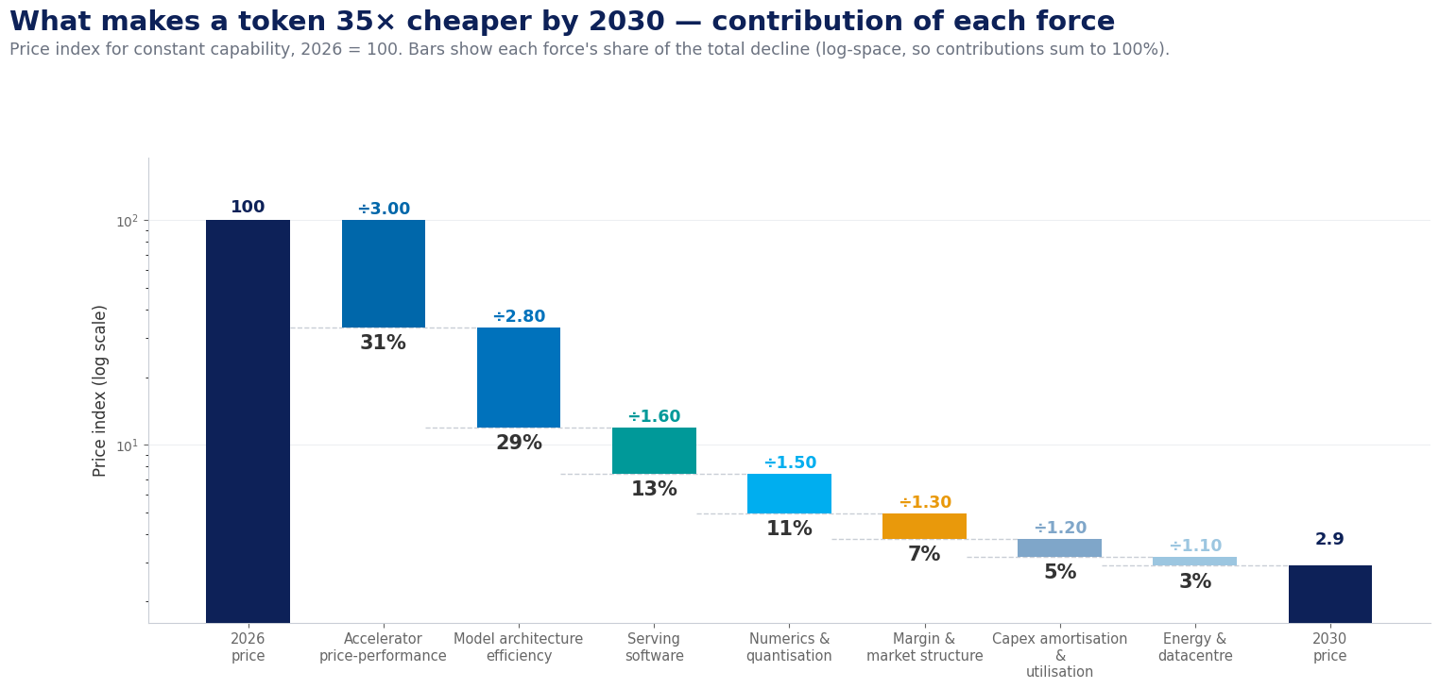
QUANTIFYING THE SUPPLY SIDE
What makes a token 35× cheaper by 2030 — force by force
PRICE, CONSTANT CAPABILITY
÷35
▼ 97% cheaper by 2030
SILICON + NUMERICS
42%
of the total decline
MODELS + SOFTWARE
42%
not chips — model design
THE HEADLINE FINDING
Half the coming price fall is software and model design, not silicon. Energy contributes under 3% — it constrains where capacity is built, not what a token costs.
Notes:
• This is the slide that makes the case defensible — we are not asserting cheaper tokens, we are decomposing them.
• Method in one line: cost per token is a PRODUCT of independent efficiency terms, so we take logs and each force gets a share that sums to exactly 100%.
• Base case: 35× cheaper by 2030 — 97% — consistent with Gartner's >90% and with the observed tapering from 10×/year.
• The finding to land: silicon and numerics are 42%, but models and serving software are another 42%. Half the deflation is software, not chips.
• Energy is under 3% — it decides WHERE capacity gets built, not what a token costs. Expect pushback on this; it is counter-intuitive.
• If challenged on ranges: constrained case is 10×, accelerated is 100× — Section 8.5 carries both through to spend.
• → Same treatment for demand.

Slide 44
DEMAND-SIDE TRENDS
Consumption explodes; sovereignty becomes a procurement rule
AGENTIC ADOPTION
Token consumption to rise 24x by 2030 to about 120 quadrillion tokens/month;
Agentic models can require 5–30x more tokens per task.
Machine-to-machine traffic dominates — latency-tolerant, so volume shifts into batch lanes and cost-per-task replaces cost-per-token
SOVEREIGN CLOUD SPEND
$7B→$12B+
Europe, 2025 → 2026 (Gartner)
SOVEREIGNTY & RULES
Europe sovereign cloud IaaS spending to rise from $6.9B to $12.6B in 2026; the EU AI Act can fine prohibited practices up to €35m or 7% of global turnover
Open weights are the natural substrate.
AI ACT PENALTIES
7%
BUYER MATURITY
Committed-use contracts, multi-vendor portfolios behind routing layers,
open-weight price anchors in every negotiation
AI cost management is FinOps' top 2026 priority.
of global turnover, max
TOKENS BY 2030
GEOPOLITICS
Export controls and sovereignty rules partition advanced silicon access by region
Chinese open-weight labs create a global low-price anchor
The plausible end state is regionally divergent effective token prices that portfolio buyers can arbitrage
24×
agentic consumption multiplier
NET EFFECT
Unit prices fall while total spend rises — manage cost per business outcome, not total spend.
Notes:
• Four demand forces: agentic consumption (~120× tokens by 2030, machine-to-machine), sovereignty hardening into procurement rules (EU AI Act fully applicable Aug 2026; residency ≠ sovereignty), professionalising buyers, and geopolitics keeping regional price divergence alive.
• Sovereign deployments cost a premium and favour open weights — weights you host can't be recalled by foreign statute.
• → Put the trajectory on one page.

Slide 45
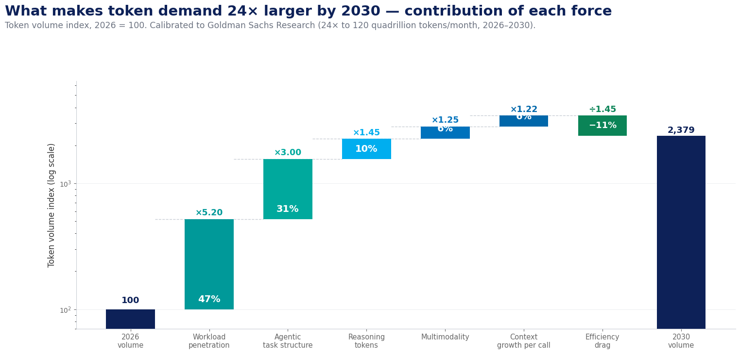
QUANTIFYING THE DEMAND SIDE
What makes token volume 24× larger — force by force
GROSS DEMAND GROWTH
×34.5
before optimisation
EFFICIENCY DRAG
÷1.45
the one lever you own
NET BILLABLE GROWTH
×24
2026 → 2030
THE ONE NUMBER YOU CONTROL
Five of the six forces are market-wide. Only the optimisation drag is yours: Push your own drag from 1.45x to 3x and you halve your token growth relative to peers while consuming the same intelligence..
Notes:
• Same arithmetic, one difference: six forces multiply demand UP, and only one — optimisation — divides it back down.
• Agentic shift is 32% of gross growth, more than adoption and breadth combined. It is also the most fragile assumption: it presumes agents reach production reliability.
• Gross growth is ~146×; an economy-wide optimisation drag of 1.45× nets it to ~100×, consistent with the 120× projection.
• The pointed message: six of seven forces are market-wide and you cannot influence them. The drag is the only endogenous term.
• Push your own drag from 1.45× to 3× and you halve your token growth while consuming the same intelligence. That is the entire case for token FinOps.
• → Multiply the two sides together.

Slide 46
TRAJECTORY
Where token economics goes from here
2026–27
2027–28
2028–29
2030
Prices fall 3–5× a year; mid-market commoditises
Outcome- and subscription-based pricing spreads
Open weights become the default substrate
Inference >90% cheaper; tokens up to 120×
Routine work shifts to small/task-specific models
routing layers become standard.
The mid-tier gets squeezed;
buyers anchor on the cheapest capable model.
Open-weight and specialist models absorb more routine volume;
portfolios become more model-agnostic.
Inference on a 1T-parameter LLM is expected to cost over 90% less than in 2025,
while token demand rises 24x to about 120 quadrillion tokens/month.
NET EFFECT
Unit prices keep falling, but token demand grows faster; the winners route work to the cheapest capable model and manage AI as a portfolio.
Notes:
• 2026–27: prices fall 3–5×/yr, mid-market commoditises. 2027–28: outcome and subscription pricing spreads. 2028–29: open weights become the default substrate. 2030: inference >90% cheaper (Gartner); tokens up to 120×.
• Unit deflation + volume explosion = aggregate spend rises. Plan for both.
• → Implications.

Slide 47
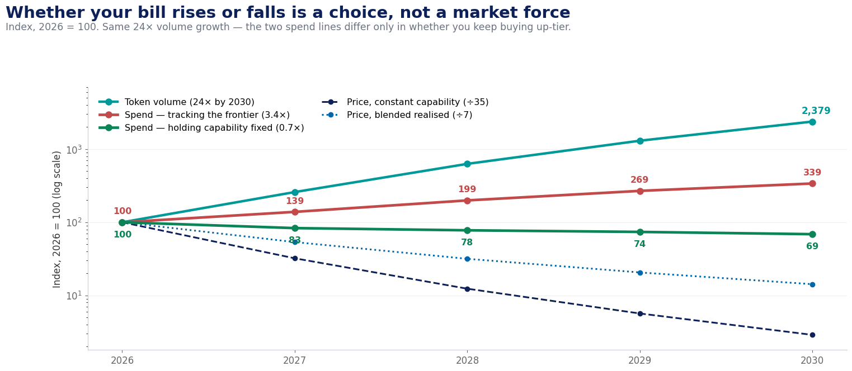
PRICE × VOLUME = SPEND
The bill is a choice, not a forecast
YEAR | PRICE (Fixed) | PRICE (Blended) | VOLUME | SPEND (Fixed) | SPEND (Up-tier)
2026 | 100.0 | 100.0 | 100 | 100 | 100
2027 | 32.2 | 53.6 | 259 | 83 | 214
2028 | 12.4 | 31.7 | 629 | 79 | 459
2029 | 5.7 | 20.6 | 1303 | 74 | 862
2030 | 2.9 | 14.2 | 2379 | 68 | 1429
2026/2030 | 35x↓ | 7x↓ | 24x↑ | 1.4x↓ | 3x↑
SAME VOLUME, OPPOSITE BILLS
Hold capability fixed and spend falls a third. Track the frontier and it triples. The deflation is real — most enterprises just spend it on more capability.
THE PLANNING NUMBER
A 35× price decline multiplied by 24× volume growth means aggregate enterprise LLM spend can fall, provided enterprises don’t move to upper-tier. But as usage increases, more powerful uses cases will demand movement to upper-tier, increasing spend by 3x.
Notes:
• This is the planning number: 35× cheaper × 100× more volume = spend still rises ~3× by 2030.
• Walk the table left to right — price index falls 100 → 2.9 while volume goes 100 → 10,037.
• Critical nuance: two price lines. The headline assumes fixed capability. Enterprises buy up-tier, so realised blended price falls only ~7×, not 35×.
• Budget against the blended line. Quote the headline line only when discussing what a specific task costs.
• If someone says 'so AI gets cheaper and our bill shrinks' — this slide is the answer. It does not.
• → How wrong could we be?

Slide 48
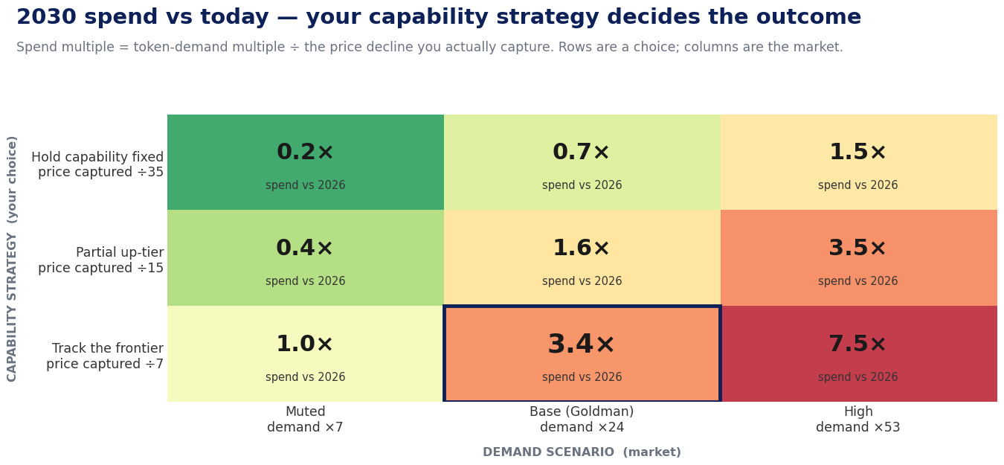
YOUR CAPABILITY STRATEGY
Same market, same volume growth — opposite outcomes
HOLD CAPABILITY FIXED
0.7×
spend falls ~a third
TRACK THE FRONTIER
3.4×
spend triples
THE SPREAD
5×
between two choices, same market
NOT AN ARGUMENT FOR FREEZING CAPABILITY
Buying up-tier is often right — better models finish tasks in fewer attempts. It is an argument for deciding deliberately, per workload, instead of discovering it in the invoice.
Notes:
• Nine scenarios. Scenarios scale the TOTAL movement rather than setting every driver to its extreme — that would imply perfect correlation and give an absurd range.
• Base case centre cell: 2.9× spend. Worst realistic corner: 31.7× if deflation stalls and agents go everywhere.
• Only one of nine cells implies falling spend, and it requires agentic adoption to disappoint badly.
• The spread between cells is ~30× — set far more by consumption discipline than by which vendor you choose.
• Use this when the board asks for a single number: give them the range and the lever, not false precision.
• → Back to implications.

Slide 49
IMPLICATIONS
Move up-stack
Monetise agents, governance and tools — not raw tokens.
What it means for suppliers
Unit economics
Blackwell-class and successor silicon keep lowering the cost floor.
Mid-market commoditize
Pure inference hosting converges on utility economics: scale, utilisation, and energy decide winners; the business starts to resemble cloud storage or CDN, not software.
Move up-stack (Frontier Premium)
Pricing power persists only where open models cannot yet match. Monetise agents, governance, and tools — not raw tokens.
Outcome pricing
Per-token billing gives way to subscriptions, per-action, and per-outcome pricing; raw tokens become the wholesale layer.
Vertical Integration
Custom silicon, owned data centers, and energy procurement become the margin defense for anyone serving at scale.
THE STRATEGIC IMPLICATION
Pure inference becomes a utility; durable margins shift to platforms, tools, and vertical integration.
Notes:
• Suppliers: mid-market becomes utility economics; pricing moves up-stack toward agents, tools and outcomes.
• Buyers: portfolio models refreshed quarterly; open weights by default; manage cost per outcome.
• The strategic risk has inverted: the danger now is under-consuming intelligence, not overspending on it.
• → Close on that thought.

Slide 50
IMPLICATIONS
Move up-stack
Monetise agents, governance and tools — not raw tokens.
What it means for buyers
Bills rise even as prices fall
Budget for aggregate growth driven by agentic adoption; manage cost per business outcome, not total spend.
Token FinOps
Metering, routing, caching, and agent budgets become standard platform-engineering functions.
Portfolio models
Any static model selection is mispriced within months; route behind an abstraction layer and capture deflation automatically.
Open weights by default
Frontier APIs for the hard tail; distilled and open models absorb the volume; portability doubles as negotiating leverage.
THE STRATEGIC IMPLICATION
Through 2025 the risk was overspending on AI. From here, the greater risk is under-consuming it: competitors who industrialize agentic workflows convert the same dollar of spend into far more output. Optimization should fund expansion, not contraction.
Notes:
• Suppliers: mid-market becomes utility economics; pricing moves up-stack toward agents, tools and outcomes.
• Buyers: portfolio models refreshed quarterly; open weights by default; manage cost per outcome.
• The strategic risk has inverted: the danger now is under-consuming intelligence, not overspending on it.
• → Close on that thought.

Slide 51
The greater risk now is under-consuming intelligence — optimisation should fund expansion.
“
“
Notes:
• Closing message: optimisation is not about spending less — it is about buying more intelligence per dollar than your competitors.
• Ask: leave with one commitment — stand up the gateway and the dashboard this quarter.
• → Thank you; annexure follows for reference.

Slide 52
Thank You
July 2026
Notes:
• Thank the audience; open Q&A.
• Annexure has the reference tables: glossary, cost stack, workload math, sources.

Slide 53
Annexure
Reference tables, definitions and sources
STRICTLY CONFIDENTIAL © GROUP DIGITAL
Notes:
• Annexure divider — reference material for follow-up questions.

Slide 54
APPENDIX
Glossary — the terms that matter
TERM | MEANING | WHY IT MATTERS
Token | ~¾ of a word | The billing meter
Context window | Tokens read per call | Re-sent every turn
KV cache | Attention state in GPU | Long-context tax
Prefill / decode | Prompt pass / output | Output costs 3–8×
MFU | Achieved vs peak FLOPs | Utilisation = cost
Distillation | Big model → small | Up to 10× cheaper
Detailed tables, methods and sources: the two companion research reports (July 2026).
Notes:
• Glossary I: the core serving-economics vocabulary.

Slide 55
APPENDIX · GLOSSARY II
The 2026 vocabulary — hardware, agents and governance
TERM | MEANING | WHY IT MATTERS
Reasoning tokens | Hidden chain-of-thought output, billed but not shown | 3–10× effective output cost
MoE | Mixture-of-Experts — a fraction of weights active per token | Cheaper serving; key 2025–26 price driver
HBM | High-bandwidth memory stacked beside the GPU die | Caps decode speed; gates price declines
ASIC / LPU | Silicon purpose-built for inference | ~40% of inference by 2026; new price floors
SLM | Small language model (~1–15B), often task-tuned | 10–30× cheaper on routine agent steps
AI gateway | Proxy doing metering, routing, caching, budgets | The token-FinOps enforcement point
Semantic caching | Similarity-matched answer reuse | 40–70% savings on FAQ-like traffic
Speculative decoding | Small model drafts; large model verifies | 2–3× decode speed-up
Continuous batching | Dynamic packing of requests per forward pass | The ~85% marginal-cost lever
PUE | Facility power ÷ IT power | 1.2–1.4 typical; multiplies every GPU watt
Sovereign AI | Deployment under a jurisdiction's legal control | Premium-priced; favours open weights
Chinchilla scaling | Compute-optimal model-size / data ratio | Training cost is a design choice
Notes:
• Glossary II: the 2026 vocabulary — hardware (HBM, ASIC), agents (SLM, reasoning tokens) and governance (gateway, sovereign AI).

Slide 56
APPENDIX · COST STACK
What a provider must recover — the full stack
COST COMPONENT | NATURE | SHARE / NOTE
GPU capex / depreciation | Fixed; amortised over ~3–5 years; utilisation decides | ~50–60% of serving cost
Energy & datacentre | ~700 W per GPU + cooling and facility overhead | ~10–20% of serving cost
Networking / interconnect | NVLink / InfiniBand; latency taxes fast decoding | Grows with size & speed
Training amortisation | $100M–$1B+ over a 12–18-month half-life | Proprietary only
R&D, safety, data, talent | Frontier-lab overhead incl. data licensing | Proprietary only
Idle / peak capacity | Latency SLAs force headroom that still depreciates | Why batch is 50% off
Margin | Value-based at the frontier; razor-thin commodity | The strategic variable
Open-weight hosts carry only the first three rows — the structural reason the same capability differs ~10× in price.
Notes:
• The full supplier cost stack — use in pricing negotiations: open hosts carry only the top three rows.

Slide 57
APPENDIX · REFERENCE MATH
Workload costs and the self-hosting break-even
SCENARIO (100K REQ/MO) | REQUEST SHAPE | FLAGSHIP API | MID TIER | VALUE TIER
Lean assistant | 2,000 in + 500 out | ~$1,250 | ~$650 | ~$185
RAG-heavy assistant | 5,000 in + 700 out | ~$2,300 | ~$1,250 | ~$325
Basis: list prices, no discounts, tools or vector costs. The workload-shape gap can rival the gap between providers.
THE SELF-HOSTING BREAK-EVEN
Favours self-hosting
Favours staying on APIs
High-volume, steady traffic — good batching economics
Relaxed latency; narrow tasks a distilled model absorbs
Data-residency or air-gap requirements add real value
Spiky, latency-sensitive traffic — poor utilisation
Capability needs that track the frontier
Below ~$15–20K/month steady spend; scarce GPU-ops talent
Notes:
• Reference math for workload costing and the self-hosting break-even discussion.

Slide 58
APPENDIX · SOURCES
Selected sources and further reading
MARKET & PRICING
RESEARCH, POLICY & OPERATIONS
· a16z — LLMflation: LLM inference cost trends
· Epoch AI — Inference economics of language models; price trends
· Gartner — LLM inference cost forecast to 2030 (Mar 2026); task-specific model & sovereign-cloud forecasts
· NVIDIA — Blackwell/Rubin cost-per-token; SLMs for agentic AI (arXiv 2506.02153)
· TrendForce — inference chip architecture & ASIC share; HBM pricing
· SemiAnalysis / EE Times — HBM4 roadmap and CES 2026 state of memory
· Provider pricing pages — OpenAI, Anthropic, Google, AWS Bedrock, DeepInfra, Together, Fireworks (July 2026)
· Chinchilla (arXiv 2203.15556); PaLM MFU (2204.02311)
· LoRA (2106.09685); QLoRA (2305.14314); AWQ (2306.00978); vLLM (2309.06180)
· Epoch AI — Inference economics (arXiv 2506.04645)
· FinOps Foundation — State of FinOps 2026: AI cost management
· CloudZero — State of AI Costs survey 2026
· EU AI Act (Regulation 2024/1689) — application timeline; US CLOUD Act analyses
· Microsoft/Constellation, AWS/Talen, Google/Kairos — nuclear power agreements
· Braintrust, PointFive — LLM gateway & token-optimisation tool landscape 2026
Full claim-level citations: Appendix C of the companion document, LLM Tokenomics v2 (July 2026).
Notes:
• Sources; full claim-level citations live in Appendix C of the Word document.

